Slide 1
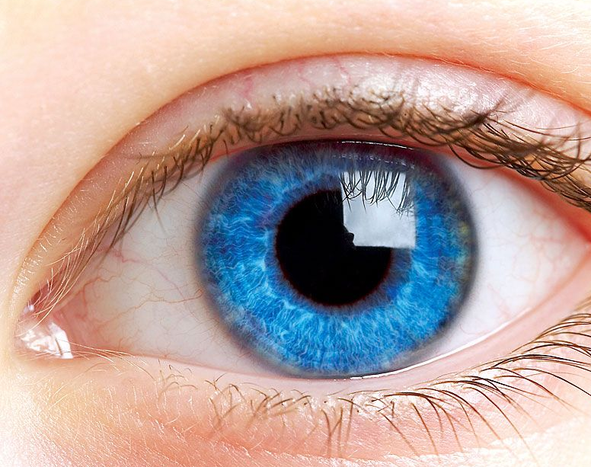
PREDICTION OF CARDIOVASCULAR RISKS FROM JUST AN EYE SCAN
Presented by
AILNENI SANTHOSH (20J21A6602)
VAKITI BHANU PRAKASH (20J21A6609)
MANGLIGE UMESH (21J25A6603)

Slide 2
TABLE OF CONTENTS
1 ABSTRACT
2 INTRODUCTION
3 LITERATURE SURVEY
4 SYSTEM ANALYSIS
6 SYSTEM DESIGN
7SYSTEM IMPLEMENTATION
8SYSTEM TESTING
9 OUTPUT SCREENS
10 CONCLUSION
5 SOFTWARE REQUIREMET SPECIFICATION

Slide 3
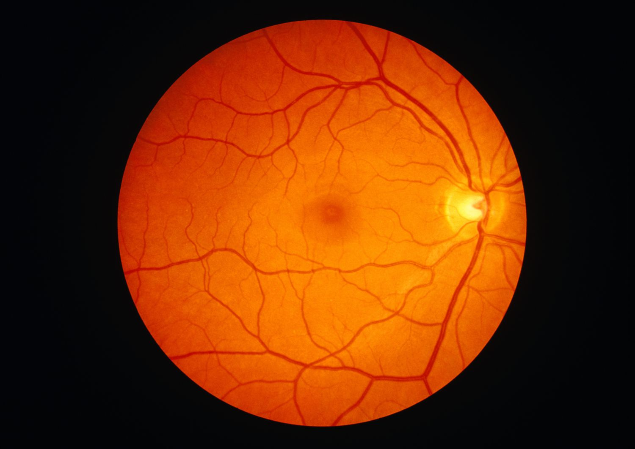
ABSTRACT
Cardiovascular diseases (CVDs) are the leading cause of death worldwide.
Traditional CVD risk assessment methods are invasive, time-consuming, and expensive.
Recent studies suggest that retinal images can be used to predict CVD risks non-invasively..
These algorithms are trained on large datasets of retinal images with manually annotated CVD risk labels.
Once trained, they can automatically predict CVD risks in new retinal images.
Deep learning-based CVD risk prediction systems have shown high accuracy in clinical studies, outperforming traditional methods with accuracies around 60-70
Bye .Bye ..! Imaging tests such as MRI, CT scans

Slide 4
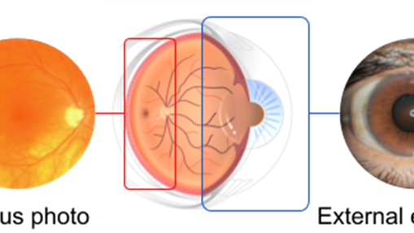
INTRODUCTION
Leading cause of death worldwide, responsible for 17.9 million deaths in 2015.
Affects older adults more, with 85% of people over 80 having CVD in the US.
Fundus photos can detect eye diseases like diabetic retinopathy (DR) and age-related macular degeneration (AMD).
AI (Artificial Intelligence) can analyze these photos for automated disease classification.
Standard CVD risk assessment uses patient history and blood samples.
Retinal images contain information about vascular health and potential CVD risk.
Deep learning can extract and quantify cardiovascular risk factors from these images

Slide 5

LITERATURE SURVEY
1, AI-Enabled Imaging of Retina Can Predict Cardiovascular Disease/Death
Focus:
Analyzed studies using AI-powered retinal image analysis to predict cardiovascular disease (CVD) and mortality.
Key Findings:
Promising accuracy of AI algorithms in predicting CVD risk and death (AUCs > 0.8 in some models)..
AI-based analysis of retinal vasculature (QUARTZ algorithm) effectively predicts CVD and death, especially in high-risk individuals.
Non-invasive and potentially remote screening, eliminating need for blood tests or pressure measurements.
Improved risk prediction compared to traditional methods, capturing 50-63% of future CVD deaths in high-risk groups.

Slide 6

SYSTEM ANALYSIS
EXISTING SYSTEM:
In Existing system, we currently are used for identifying the cardiovascular risks
1. Medical History and Physical Examination
2. Blood Tests
3. Image-based Tests

Slide 7

EXISTING SYSTEM
1 Medical history and physical examination:
Symptoms
Risk factors
Past medical history
2 Blood Tests
Lipid Panel
Blood Sugar Tests
3 Imaging based Tests
Electrocardiogram (ECG)
Echocardiogram
Magnetic Resonance Imaging (MRI) Scans

Slide 8

EXISTING SYSTEM
DISADVANTAGES OF EXISTING SYSTEM
Limited accuracy
Limited clinical adoption
Huge Noise pollution

Slide 9

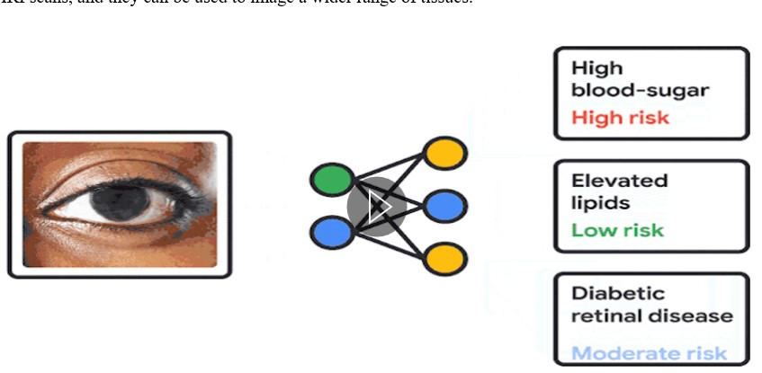
PROPOSED SYSTEM

Slide 10
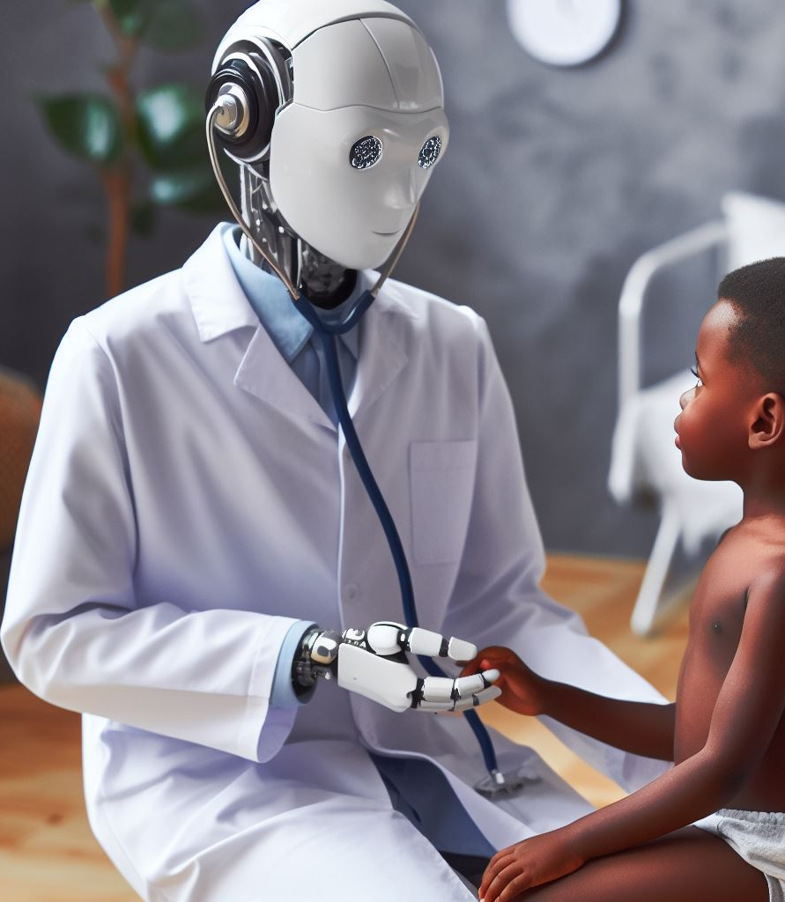
PROPOSED SYSTEM
ADVANTAGES OF PROPOSED SYSTEM
Cost-Effective
Early Results
Bye .. Bye! To Imaging-based Tests
No- Radiation Exposure

Slide 11

SOFTWARE REQUIREMENTS
HARDWARE REQUIREMENTS
Operating System : Windows 11
Hard Disk : 1 TB
RAM : Min 8GB
Processor : INTEL I5 CORE
SOFTWARE REQUIREMENTS
Environment : Jupiter, Kaggle Runtime
Languages : Python 3.9
Frameworks : TensorFlow, Pytorch

Slide 12

MODULES
Data Acquisition and Preprocessing Module
Database-Management Module
Deep Learning Model Module
Model -Evaluation Module

Slide 13

Data Acquisition and Preprocessing Module
Purpose: Gather and prepare high-quality retinal images for developing an accurate deep learning model for CVD risk prediction.
Tasks:
Capture high-resolution retinal images.
Provide primary raw data for analysis.
Annotate images with CVD risk labels (presence/absence of specific CVDs).
Conduct by medical professionals using clinical data and imaging features
Standardize image dimensions and intensities.
Ensure consistent input for deep learning models.

Slide 14

Database-Management Module
Purpose: Gather and prepare high-quality retinal images for developing an accurate deep learning model for CVD risk prediction.
Tasks:
Data Storage
Data Organization and Labeling
Data Access and Retrieval.

Slide 15
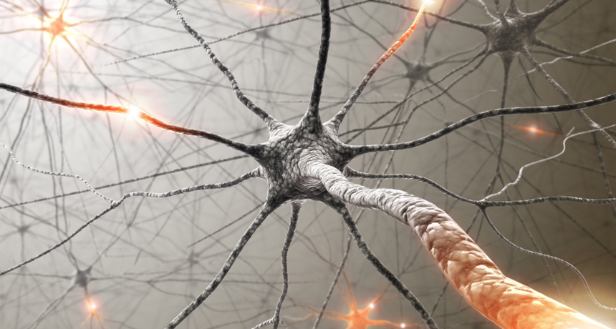
Deep Learning Model Module
Purpose: Efficiently manage, store, and access large volumes of retinal images and associated data for CVD risk prediction
Tasks:
Building the Model
Training the Model
Evaluating the Model
Refining the Model

Slide 16
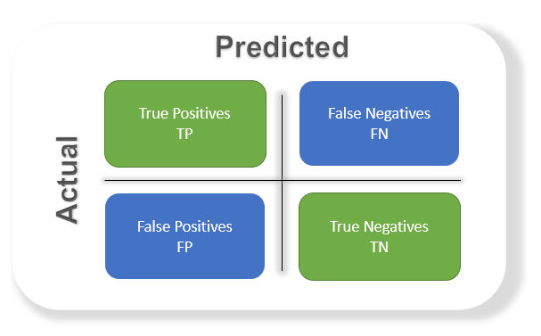
MODEL EVALUTION MODLUE
Purpose: Assesses and improves the performance of the trained machine learning model.
Tasks:
Evaluates model performance on unseen test data.
Analyzes potential errors and sources of bias.
Identifies areas for improvement (e.g., data augmentation, model architecture changes).
Refines the model through retraining, feature selection, or ensemble techniques.

Slide 17

SYSTEM DESIGN
UML DIAGRAMS
E-R DIAGRAMS
DEPLOYMENT DIAGRAMS

Slide 18
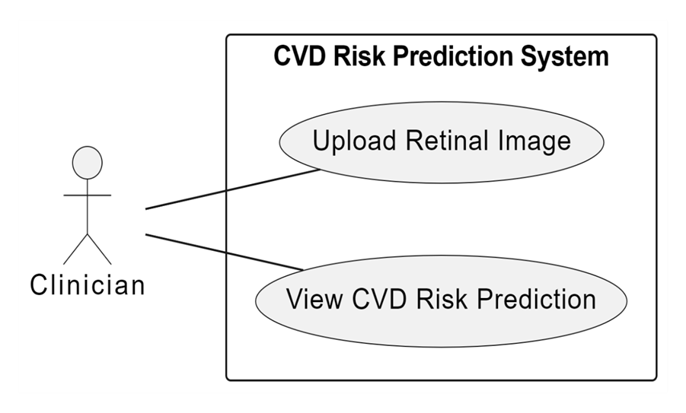
USE -CASE DIAGRAM

Slide 19
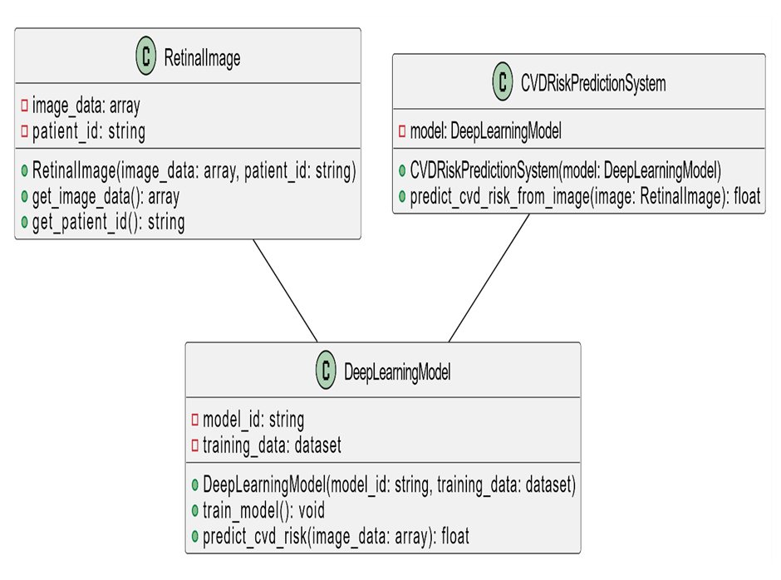
CLASS DIAGRAM

Slide 20
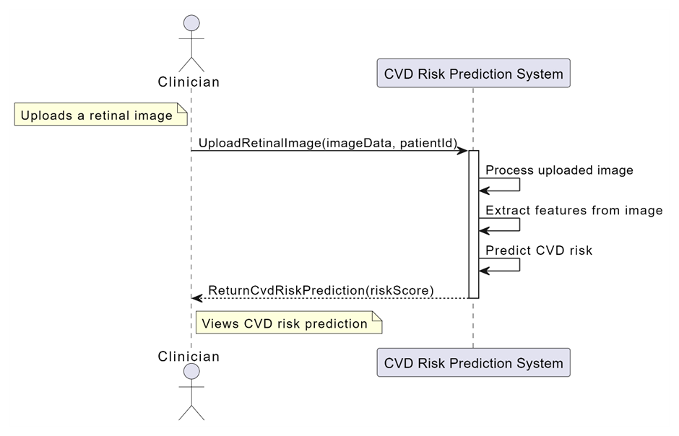
SEQUENCE DIAGRAM

Slide 21
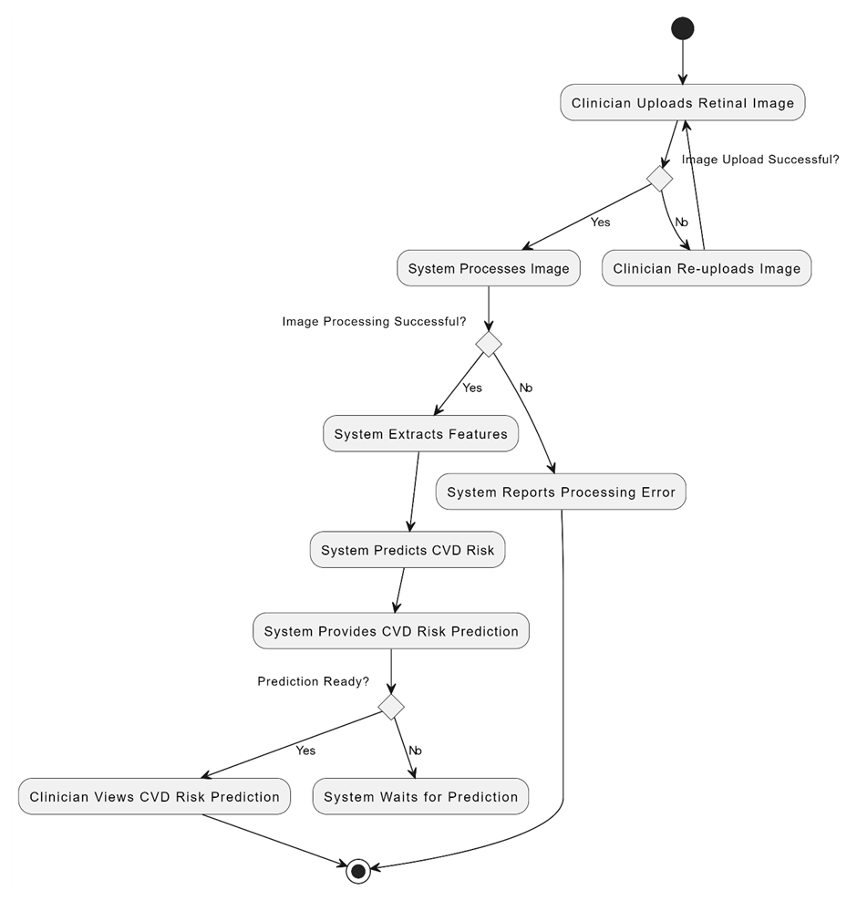
ACTIVITY DIAGRAM

Slide 22
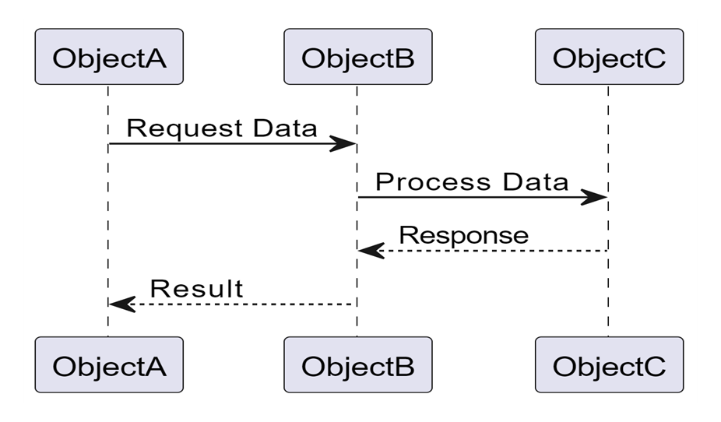
COLLABORATION DIAGRAM

Slide 23
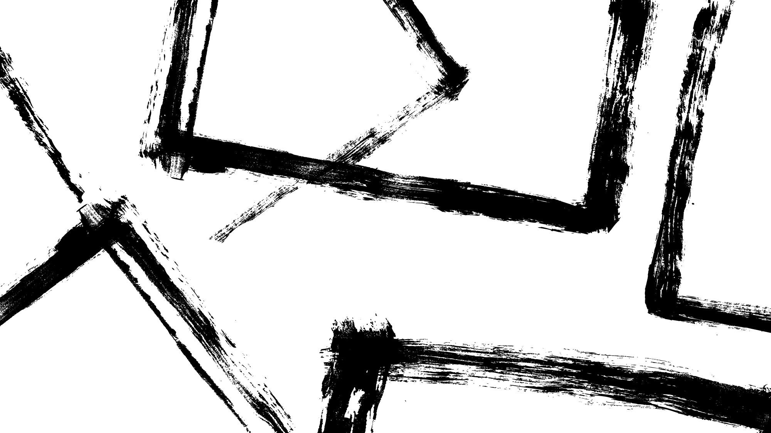
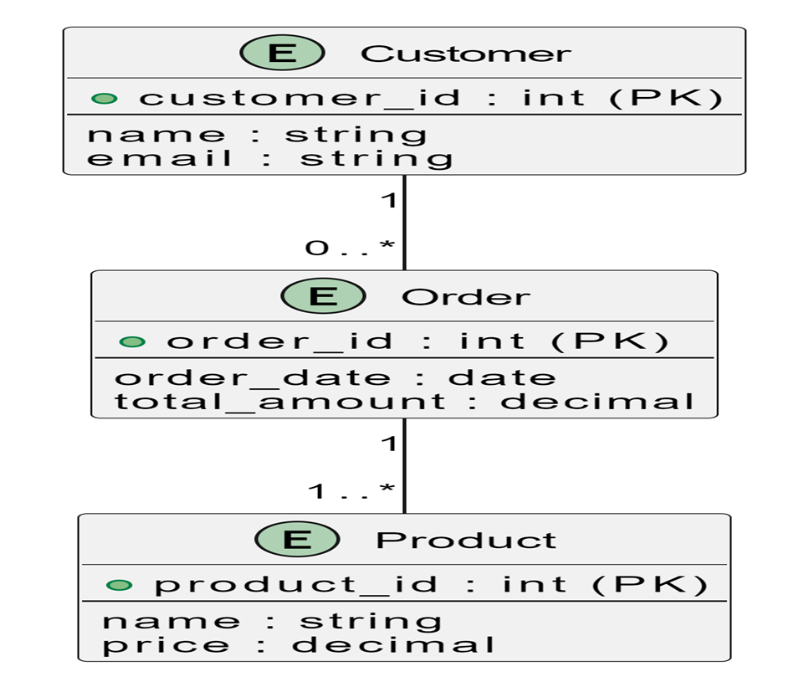
E-R DIAGRAM

Slide 24
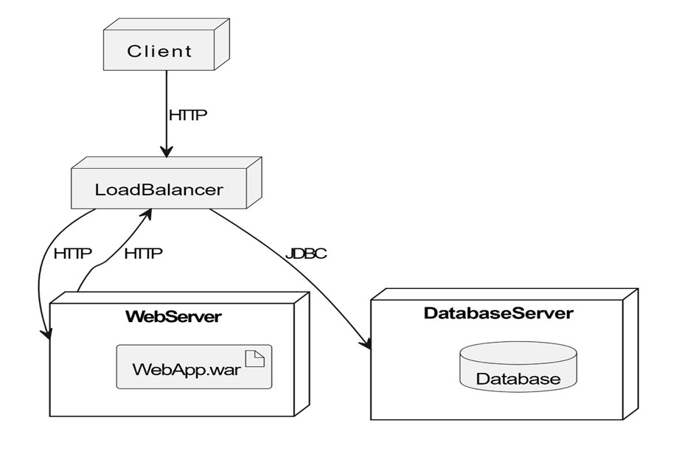
DEPLOYMENT DIAGRAM

Slide 25

SYSYEM TESTING
Accuracy Testing
Precision Testing
Recall Testing
F1score Testing

Slide 26
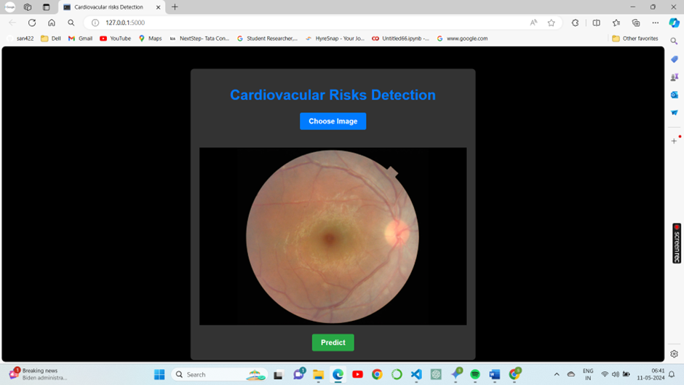
OUTPUT SCREENS

Slide 27
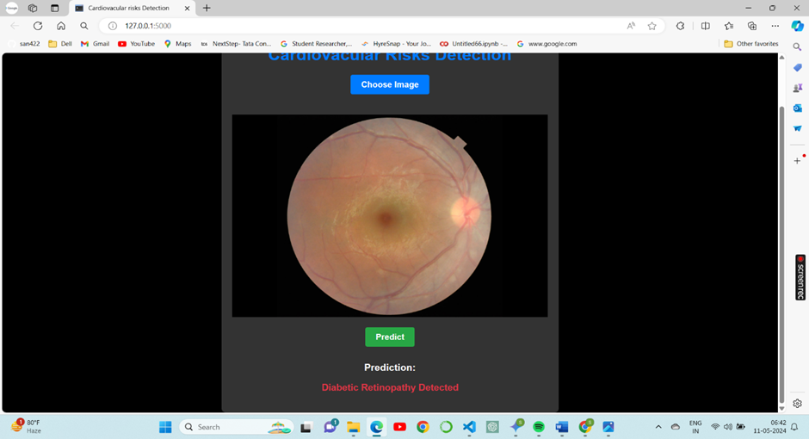
OUTPUT SCREENS

Slide 28

CONCLUSION
In this project, we have demonstrated the effectiveness of utilizing deep learning techniques for non-invasive cardiovascular disease (CVD) risk prediction using retinal images. The primary objective was to develop a robust and accurate CVD risk prediction system that can assist clinicians in early detection and intervention, ultimately reducing CVD mortality and morbidity.

Slide 29


